Slide 1


Team Rio De Janeiro

Slide 2
Contents
The business problem
Introduction to Data set
Initial exploration of the data
Models
Model Comparison
Business findings and Recommendations

Slide 3

The business problem Product Marketing

Slide 4

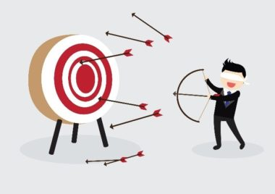

The business problem
I need a Mobile!
Ok, Here are the offers!
Awesome, Here are the offers customized to you!
I need a Mobile!

Slide 5
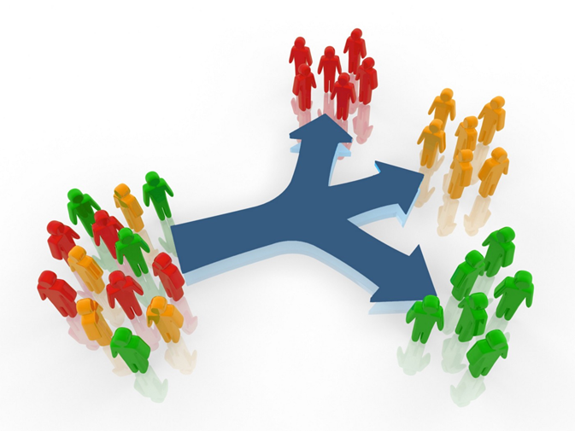
The business problem
A good marketing campaign can be the game-changer in making a product successful.
The company's marketing campaign will be more concerned about who the target customers are and how to reach each particular set of customers according to various factors, which we further discuss in more detail.
The Goal is to categorize the customers into groups and predicting the groups which are more likely to accept the product.
What ratio of the marketing budget and efforts can be spent on certain group of target customers based on their reaction to previous marketing campaigns

Slide 6

The business problem
Analyze behavior of the customer and predict whether the customer is likely to accept the marketing campaign or not.
Getting an estimate to say to what extent the customer is likely to buy a product.
Helps in sending the ads and offers to the set of customers who are more likely to buy the product with that offer.
Minimize the marketing expenditure, maximize the product sales.
By predicting we will be able to significantly boost the efficiency of the marketing campaign, this way we would be able to target the potential customers within the campaign budget.

Slide 7
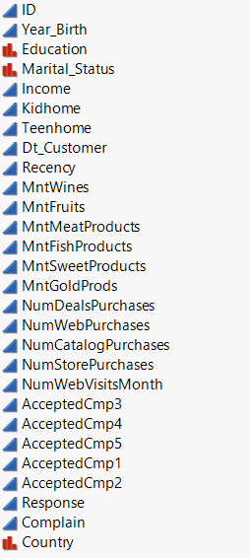
Introduction to the dataset
To Understand the behavior of the customer more accurately, the following column datatypes are changed accordingly
Changed Education to Ordinal
Changed Income to Ordinal
Converted Dt_Customer Enrolment into Months of customers relationship with the company
Clubbed AcceptedCMP into one variable
Target variable

Slide 8
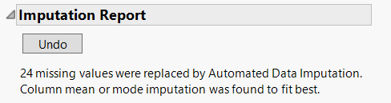
Introduction to the dataset
24 Missing values were identified in Income, These were replaced using Automated data imputation
Column mean or Mode imputation was found to be best fit
Outliers were observed in the following columns
MntWines
MntFruits
MntMeatProducts
MntFishProducts
MntSweetProducts
MntGoldProds
NumDealsPurchases
NumWebPurchases
NumCatalogPurchases
NumWebVisitsMonth
Handled using distributions fit all in Jmp, Fitted SHASH Distribution is applied to most of the above columns to handle outliers.

Slide 9
Introduction to the dataset
Upon performing Principal component analysis
We found that the following Columns are highly corelated.(With threshold value of 0.7)
MNTWines, MntMeatProducts, Income
MNTWines, NumStorePurchases
MNTWines, NumofWebPurchases
MntWines, NumOfCatalogPurchases
Clubbed all these values by adding 4 columns accordingly as shown above by saving principal components of the respective columns

Slide 10
Data Visualization

Slide 11
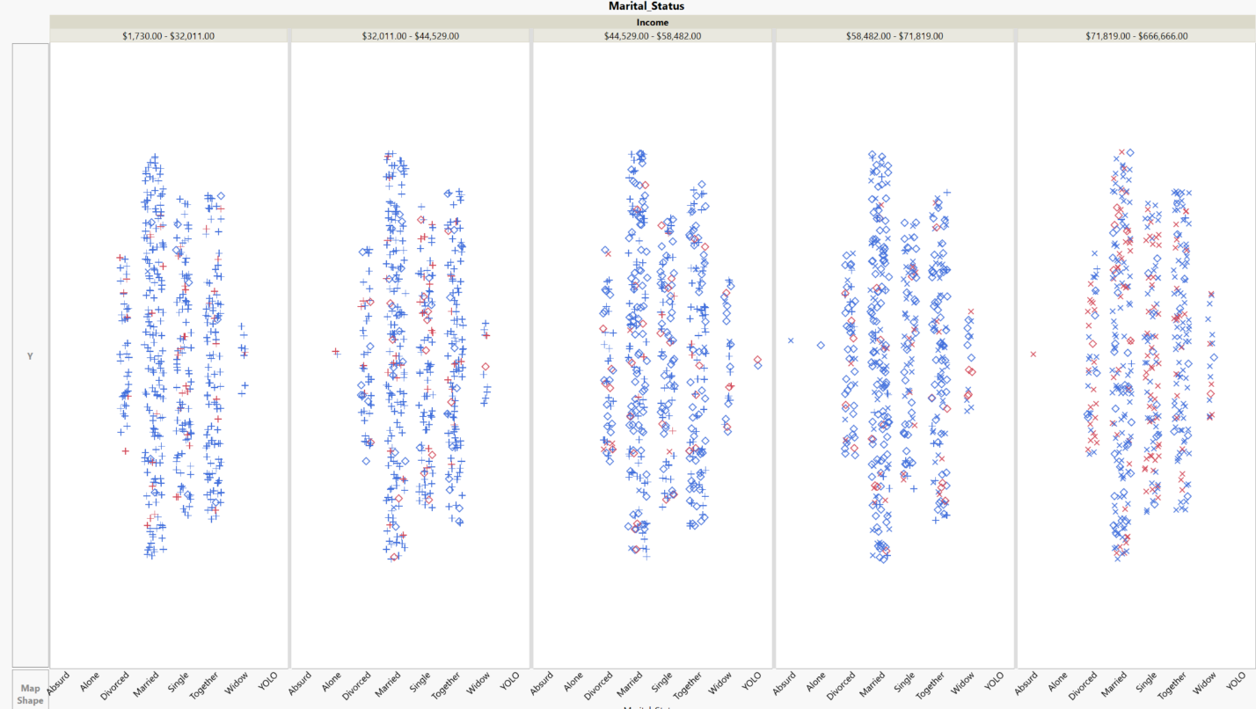
Income & Marital Status vs Response
Least Response
Highest Response
Lower Middle Income
Middle Income
Upper Middle Income
Low Income
High Income

Slide 12
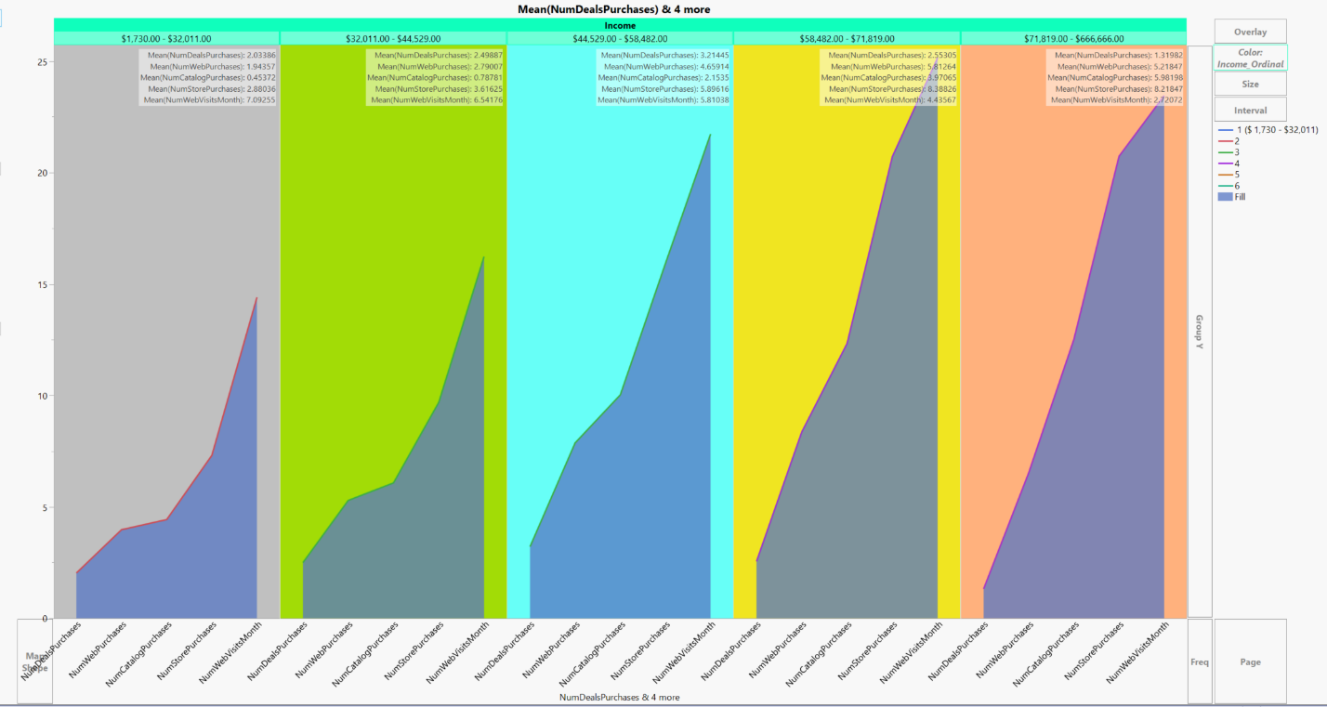
Lower Middle Income
Upper Middle Income
Low Income
Middle Income
High Income

Slide 13
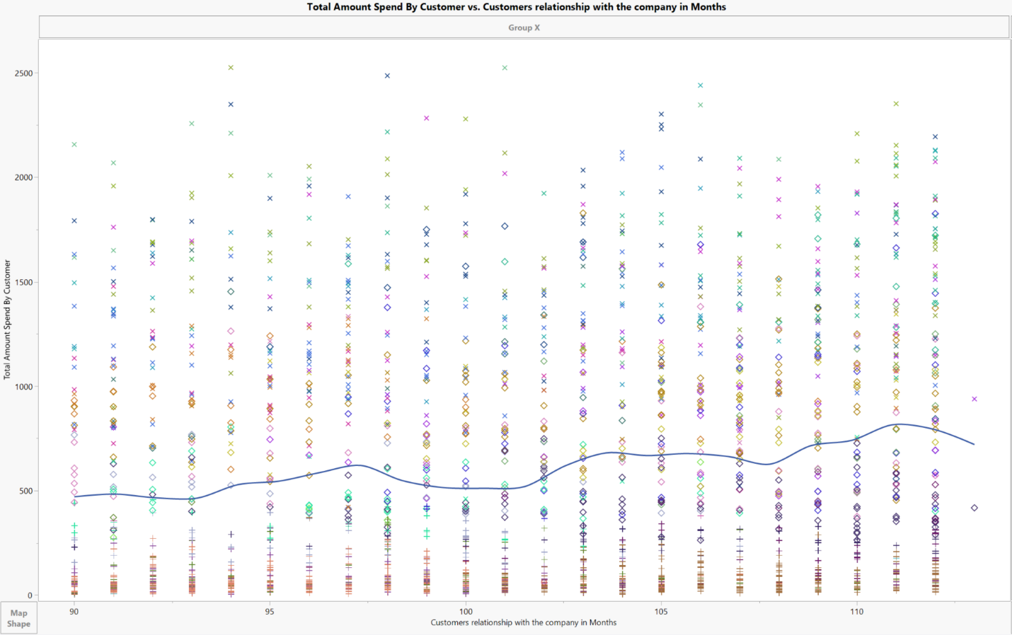
Premium Loyal Customers
High-Valued Customers
Low-Valued Customers
One – Time customers
Inherently Loyal
Customers

Slide 14
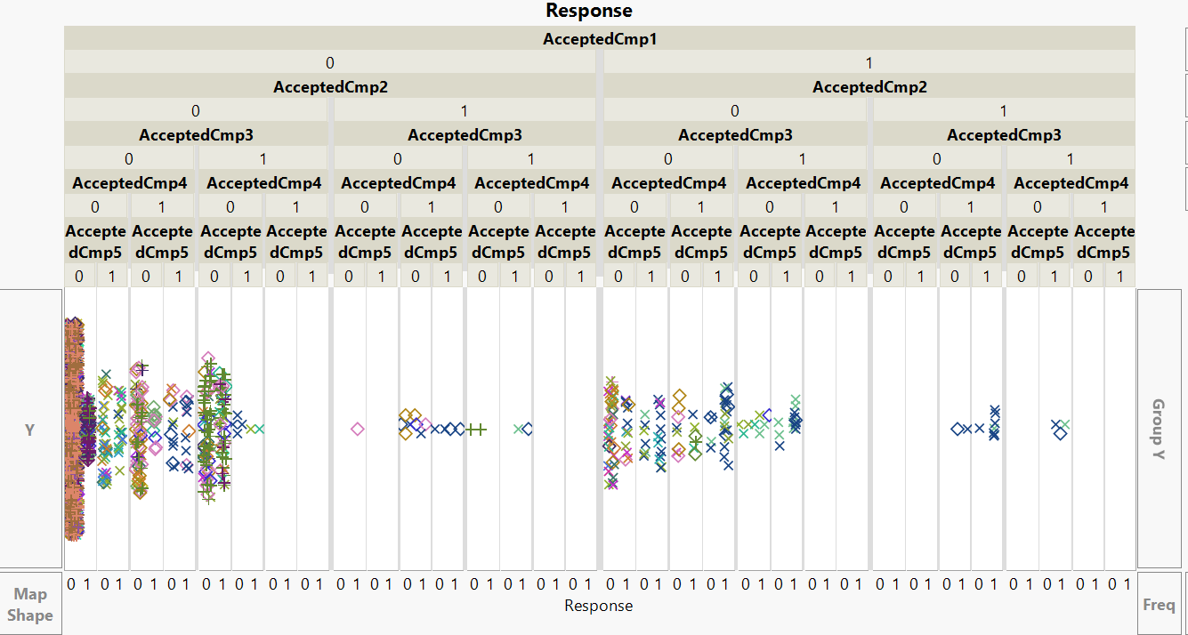
Campaign
Structure

Slide 15
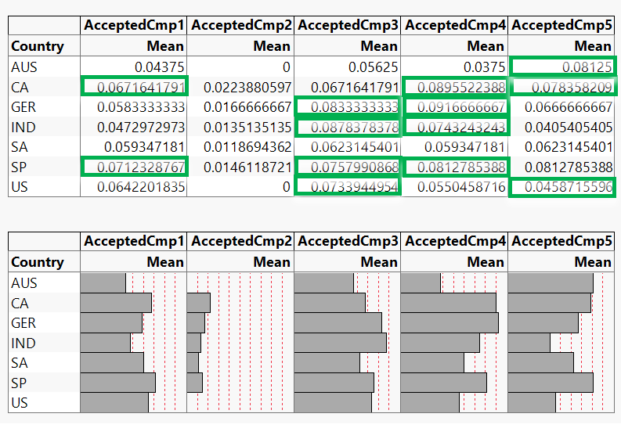
Geographical Segmentation
None of the countries did well in Cmp2

Slide 16
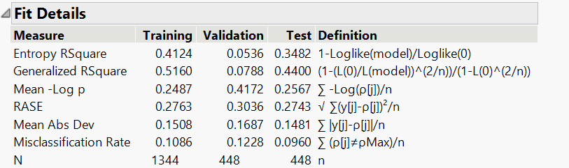
modelling
Target Variable: Response
Data Split: 60% Training, 20% validation, 20% Test
Predictor Variables: 17 continuous variables, 1 ordinal and 2 nominal variables.
Logistic Regression
Significant Columns: CompleteAcceptedCmp, Recency, Mnt Wines, mnt MeatProducts, Customer Relationship with company, Marital Status,Education status, No of Catalog Purchases
Variable Optimization: Based on a p-value, we removed all predictors that were insignificant, with a threshold p-value<=0.15. We came down to 12 significant variables.

Slide 17
MODEL COMPARISON
Ranking tables are based on Test set
Rank | Model Name | Misclassification Rate | Total Accuracy | RASE
1 | Logistic | 9.60 | 90.40 | 0.2708
2 | Neural | 9.60 | 90.40 | 0.2755
3 | Partition | 10.94 | 89.06 | 0.2940
4 | SVM | 11.16 | 88.84 | 0.2848
5 | Bootstrap Forest | 11.16 | 88.84 | 0.2857
6 | K Nearest Neighbors | 12.05 | 87.95
Ranking Table based on all predictors:
Rank | Model Name | Misclassification Rate | Total Accuracy | RASE
1 | Logistic | 9.60 | 90.40 | 0.2743
2 | SVM | 10.04 | 89.96 | 0.2815
3 | Neural | 10.26 | 89.74 | 0.2774
4 | Bootstrap Forest | 10.94 | 89.06 | 0.2781
5 | Partition | 10.94 | 89.06 | 0.2940
6 | K Nearest Neighbors | 12.27 | 87.73
Ranking Table based on 12 significant predictors:

Slide 18
Findings
Consumers who accepted more campaign offers in past campaigns are more inclined to accept the next campaign's offer.
Customers who have recently purchased a product are more inclined to accept the upcoming campaign offer.
Clients who invest more on wines and meat products are more likely to accept the next campaign offer
Customers with an annual income of more than $75,000 are more likely to accept the offer, with single status being the most important factor.

Slide 19
recommendations
For our Business Partner
The Company should provide additional promotions and deals on wine and meat goods.
Customers in the above middle-income category who are unmarried should be targeted them to enhance sales and reduce marketing campaign costs.
Offering Lucrative offers to customers who have not accepted offers in previous campaigns.
Middle and High-Income customers get more Digital advertisements in the next marketing campaign to enhance sales.

Slide 20


Slide 21
Thank you!

